Slide 1
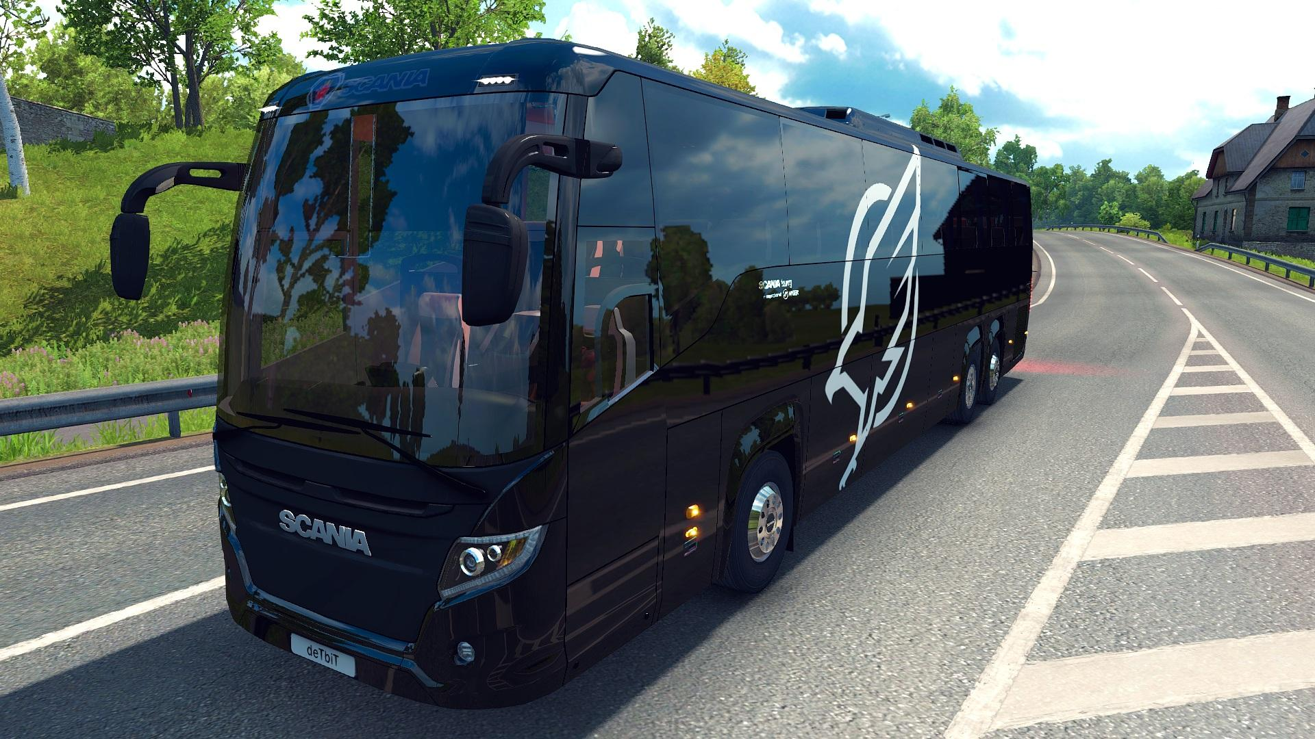
E-BUS RESERVATION SYSTEM
(

Slide 2


“E-BU Reservation System”
A Project submitted to
IACSD
Project External Mentor: Mr. Chetan Pardeshi:
Submitted by:
Group 11: Ananya Jain (219020)
Ashish Thube(219033)
Project Internal Mentor Mrs. Sneha Sapkal

Slide 3
TABLE OF CONTENTS
Introduction
Requirement Analysis
Design
Conclusion
References

Slide 4
INTRODUCTION E-Bus Reservation System is Web based application that works within centralized network. The software program “E- Bus Reservation System” provides bus transportation system, a facility to reserved seats, cancellation of seats and different types of enquiry which need an instant and quick reservation. It is built for manage and computerize the traditional database, ticket booking and tracking bus and travel made easy. It maintains all data’s of users, bus details, reservation details, booking details, customer details.

Slide 5
ANALYSIS Requirement analysis is a software engineering task that bridges the gap between the system level software allocation and software design. It enables the system engineer to specify software function and performance, indicate software interface with other system elements, and establish design constraints that the software must meet. It provides the software designer with a representation of information and function that can be translated to data, architectural and procedural design.

Slide 6
Introduction :
E-BUS Reservation System is a web application that can be used in a bus transportation system i to reserve seats, cancellation of reservation and different types of route enquiries used on securing quick reservations. It will maintain all customer details, bus details, reservation details
Problem statement :
System that are using by the staff at the counter currently is an internal system and just used to sell the bus ticket at the counter. Customer has to go to the counter to buy bus ticket or ask for bus schedule. Furthermore, customers need to pay cash when they buy the bus ticket and sometimes needs to queue up long time to get the bus ticket. Besides that, customer also not allowed to buy bus ticket through telephone and the bus company's telephone always-busy line.

Slide 7
SOLUTION
The method to solve this problem is to create an online booking bus ticket system . Customer can buy the book ticket over the Internet, 24 hours a day, 7 days a week and the bus ticket can't be lost, stolen or left behind. In addition, the online system lets the customers check the availability of the bus ticket before they buy bus ticket. Furthermore, customers no need to pay cash to buy bus ticket because they can pay the bus ticket on the traveling time.

Slide 8
SYSTEM SPECIFICATION
HARDWARE CONFIGURATION:
Computer processor : i3
Hard Disk : 50Gb(min)
RAM : 512MB(min)more
SOFTWARE SPECIFICATION:
Operating System : WINDOWS 7 or above
Language used : ReactJs(FrontEnd) ,SpringBoot(Backend).
Data Base : My-SQL
Server : Apache Tomcat 8.0

Slide 9
SCOPE
The scope of the online bus ticket reservation system is: A person should be able to login to the system through the first page of the application change the password after logging into the system should be able to create a new login for the accessing the reservation facility.

Slide 10
MODULES IDENTIFIED
User Module: User can view information of available bus, booking ticket for bus, cancel the ticket and view booked ticket details.
Admin Module: Admin can add a bus,add route ,location ,view booking list and also view feedback and enquiry.

Slide 11
Functionalities of User Module:
User
•View Available Busses:
. The user can see availability of bus .
•Booking ticket:
The user can book the ticket as per as their preferences.
•Cancel the ticket:
This system will provide the facility to user to cancel the ticket
•Give Feedback:
The user will give the feedback to the admin.
•Enquiry:
The Enquiry can easily do by user.

Slide 12
Functionalities of Admin Module:
Admin:
• In this section admin can view the details of all bus (Like total bus, total booking, enquiry)
• Admin can create/edit/delete bus details.
• The Admin can add the bus so that the user can see the available buses
• Admin can also edit and delete the bus.
• Admin can also book the details on demands.

Slide 13
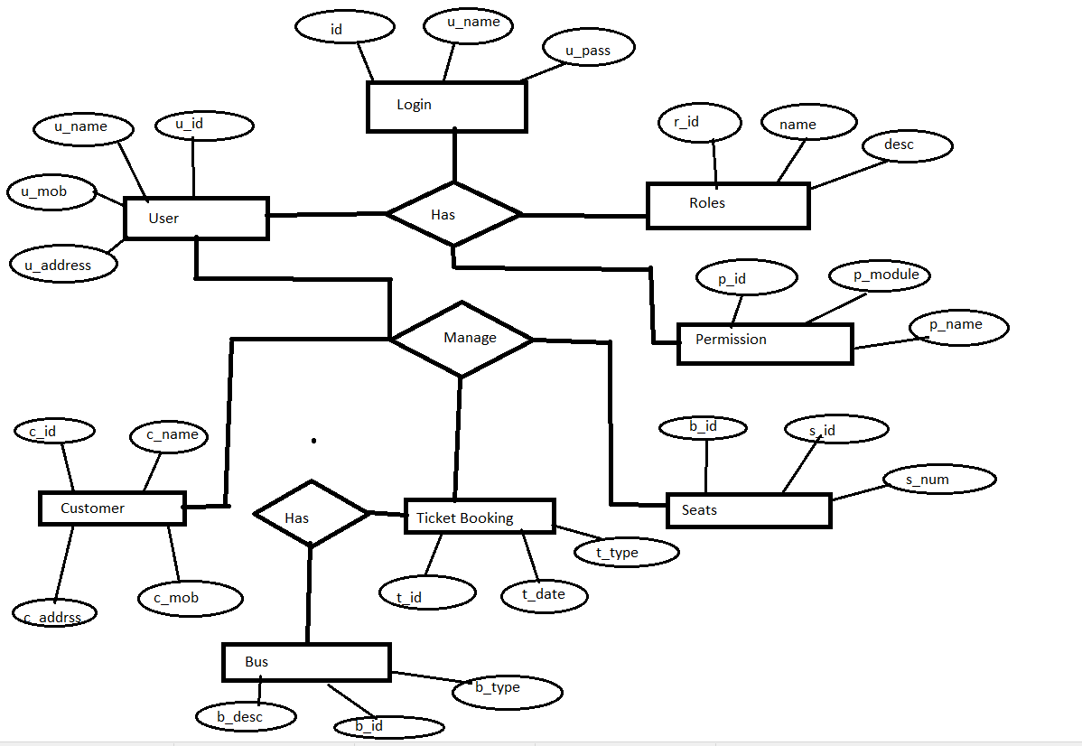
ER-Diagram

Slide 14
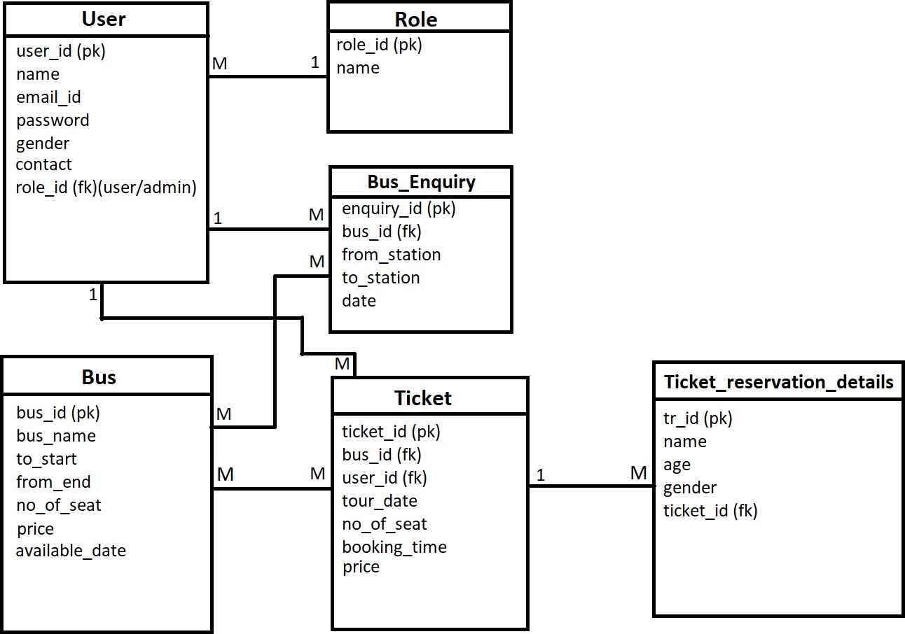
ER-Diagram

Slide 15
USE CASE DIAGRAM
“A use case is a description of a system’ behavior as it responds to a request that originates from outside of that system (the user).”
In other words a use case describes “who” can do “what” with the system in question. The use case technique is used to capture a system’s behavioral requirements by detailing scenario-driven threads through the functional requirements. The use cases describe the system from the user’s point of view! A use case is a standard set by, among other, UML 2.0. It is a non-technical description of the behavior of the system.

Slide 16
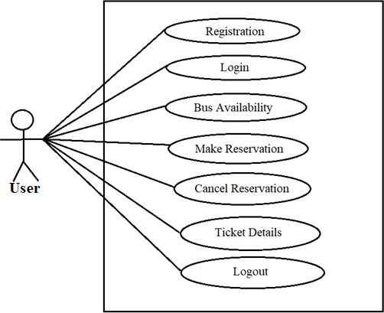
USE CASE DIAGRAM FOR USER

Slide 17
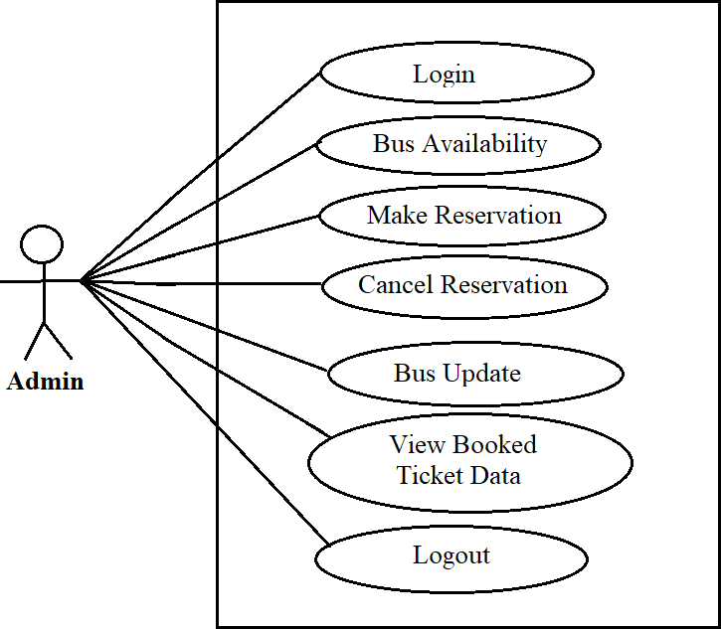
USE CASE DIAGRAM FOR GUESTUSE
ADMIN

Slide 18
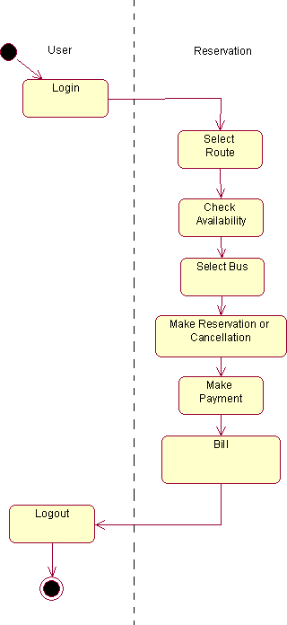
ACTIVITY DIAGRAM

Slide 19
Design
Using SRS(software requirements specification) as input, system design is done. System design included designing of software and hardware i.e. functionality of hardware and software is separated-out. After separation design of software modules is done. The design process translates requirements into representation of the software that can be assessed for quality before generation of code begins.

Slide 20
DFD DIAGRAM
A Data Flow Diagram (DFD) is a process-oriented graphical representation of an application system. A DFD "is a picture of the movement of data between external entities and the processes and data stores within a system.”
The components of a typical dataflow diagram are: the process, the flow, the data store, and the terminator.

Slide 21
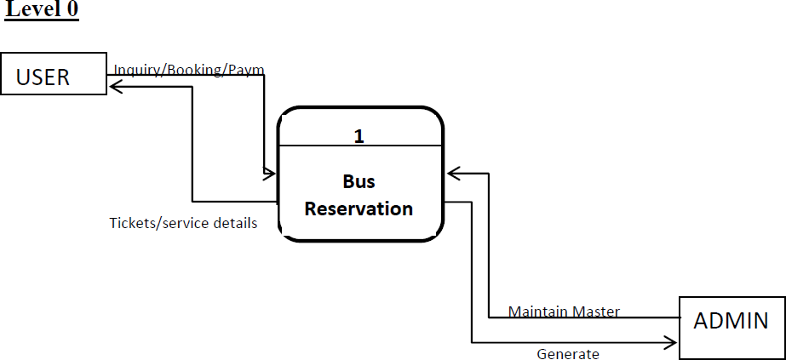
DFD DIAGRAM “0 LEVEL”

Slide 22
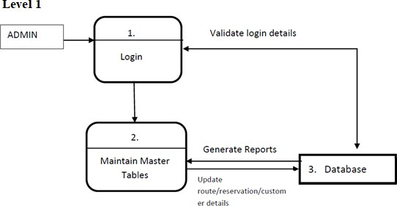
DFD DIAGRAM FOR RIGISTERED USER

Slide 23
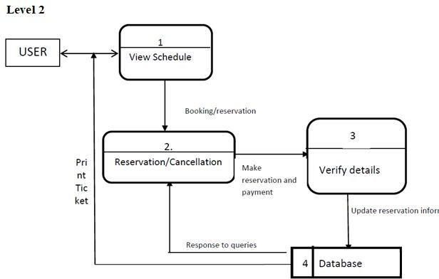
DFD FOR GUEST USER

Slide 24
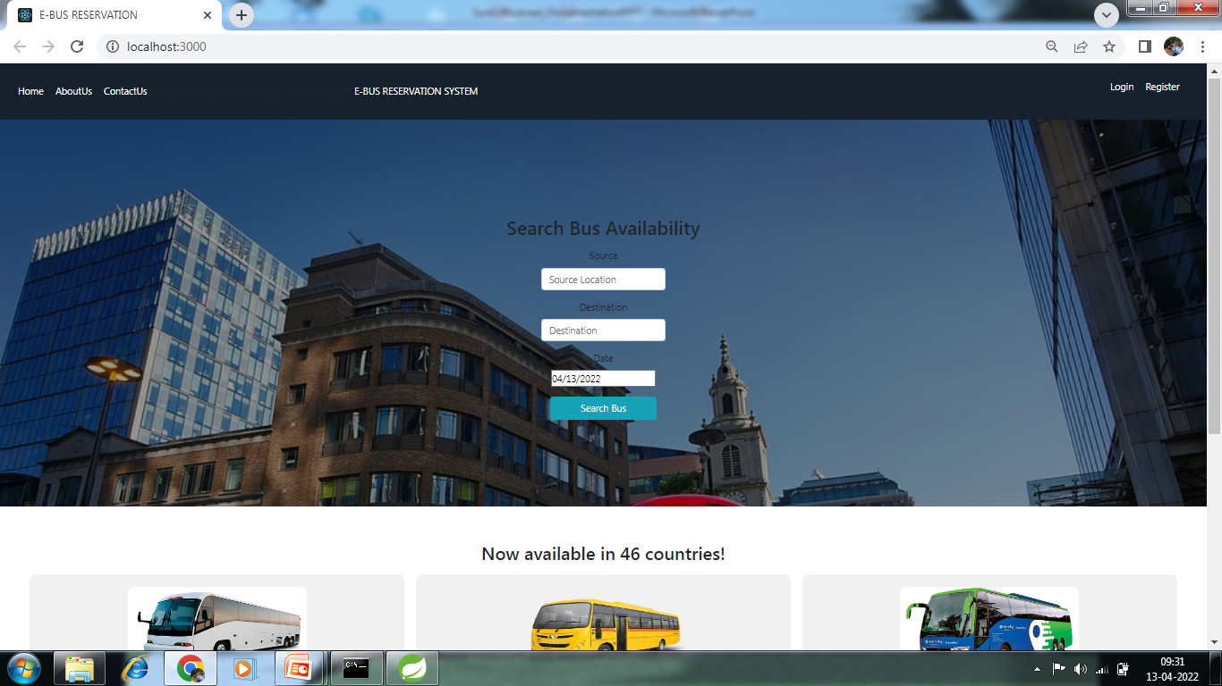
HOME PAGE

Slide 25
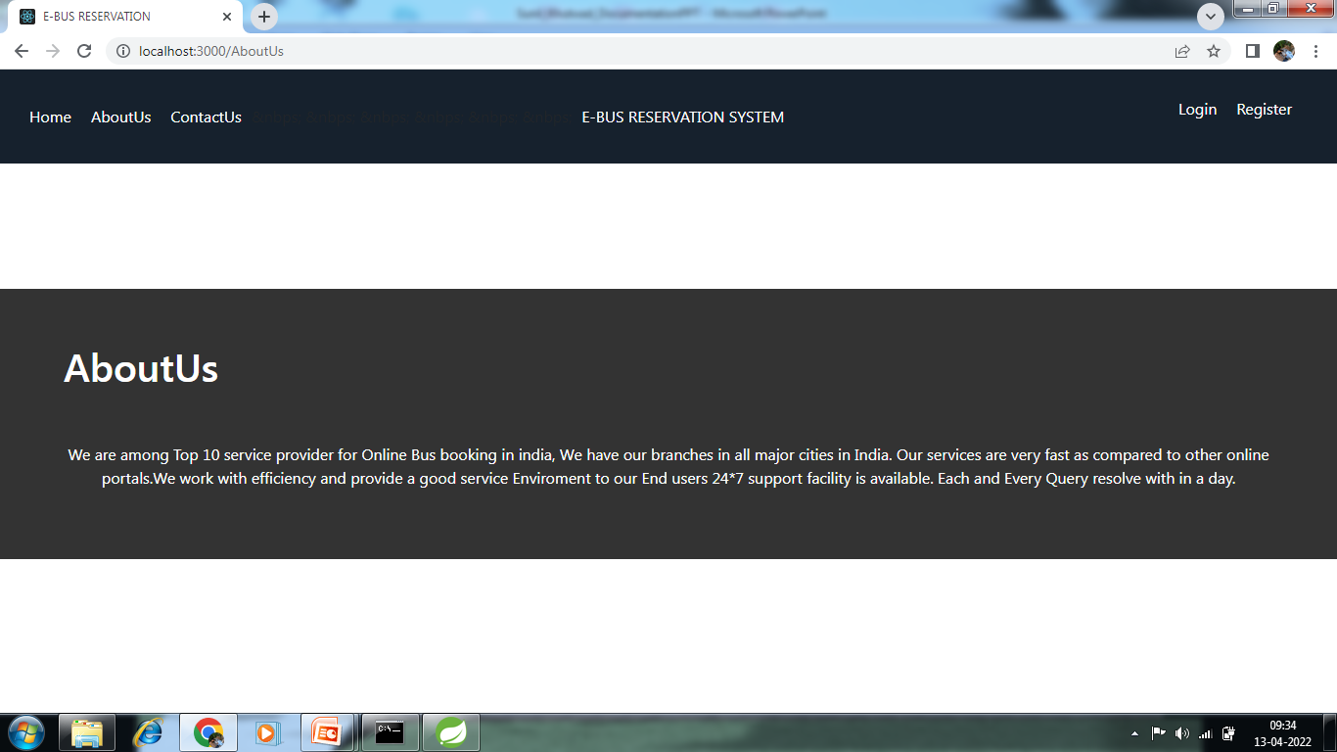
AboutUS

Slide 26
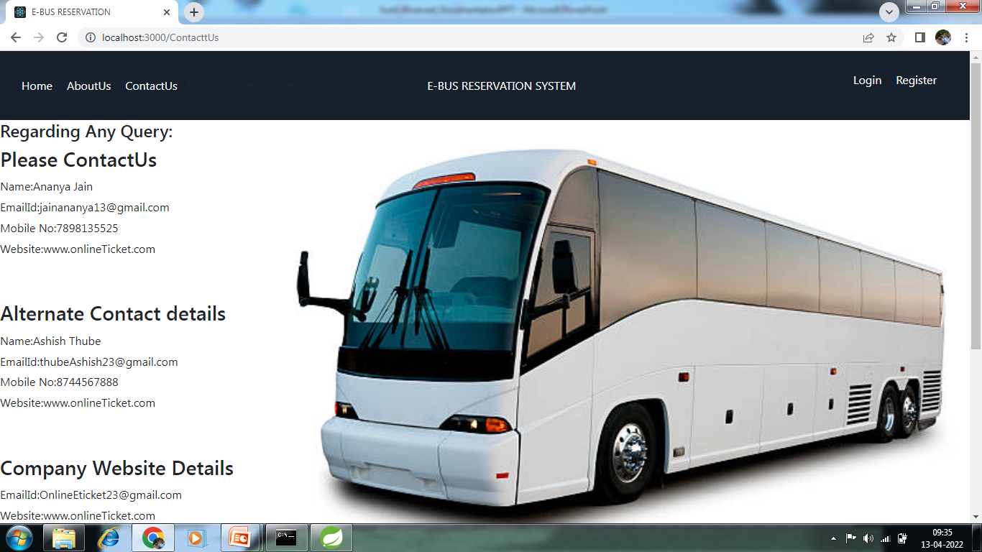
ContactUs

Slide 27
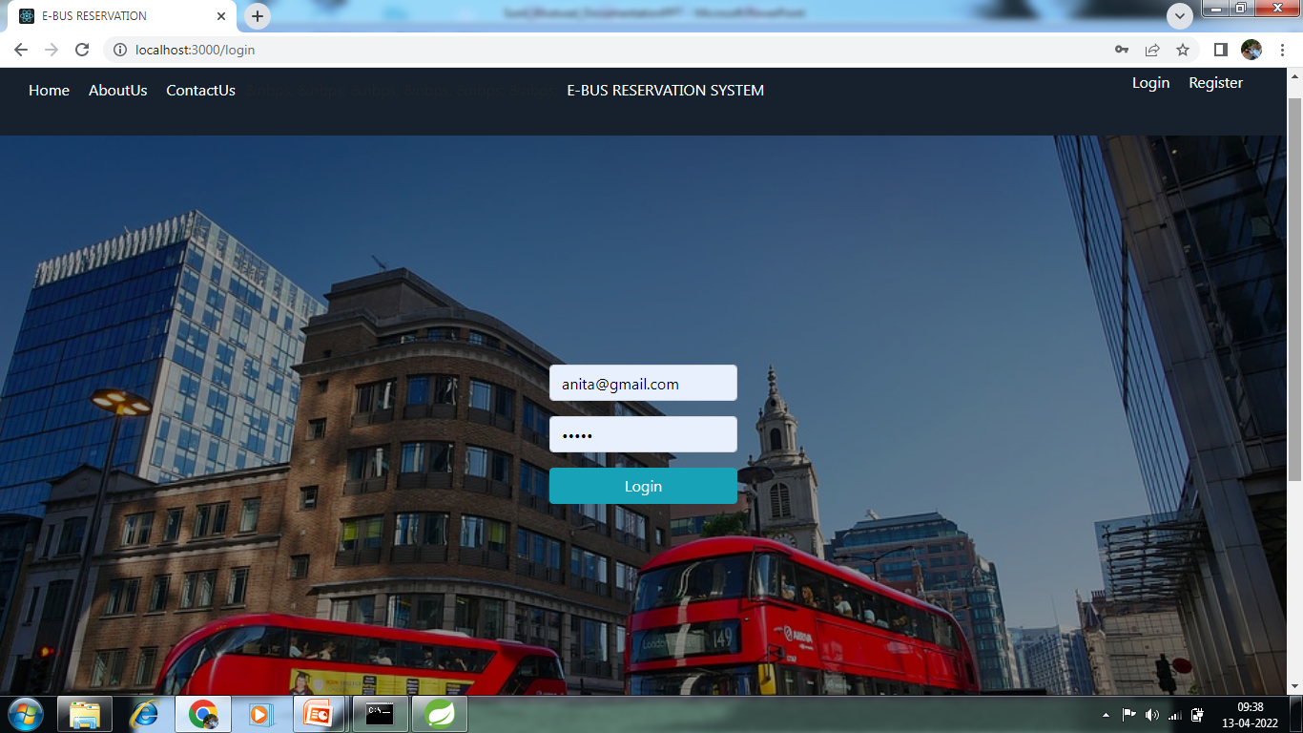
Login Page

Slide 28
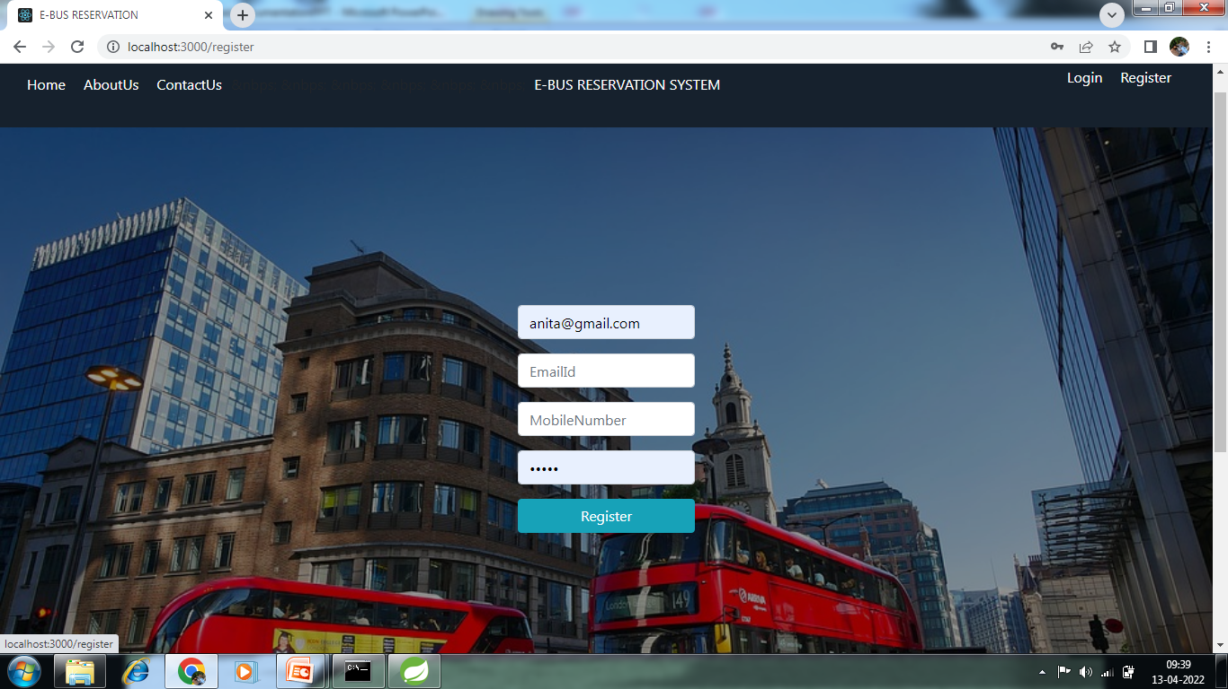
User Registration Page

Slide 29
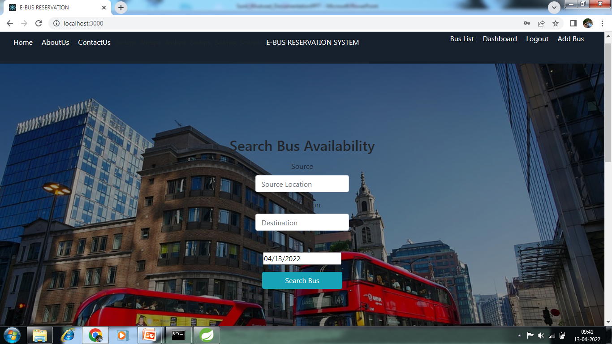
Admin Login

Slide 30
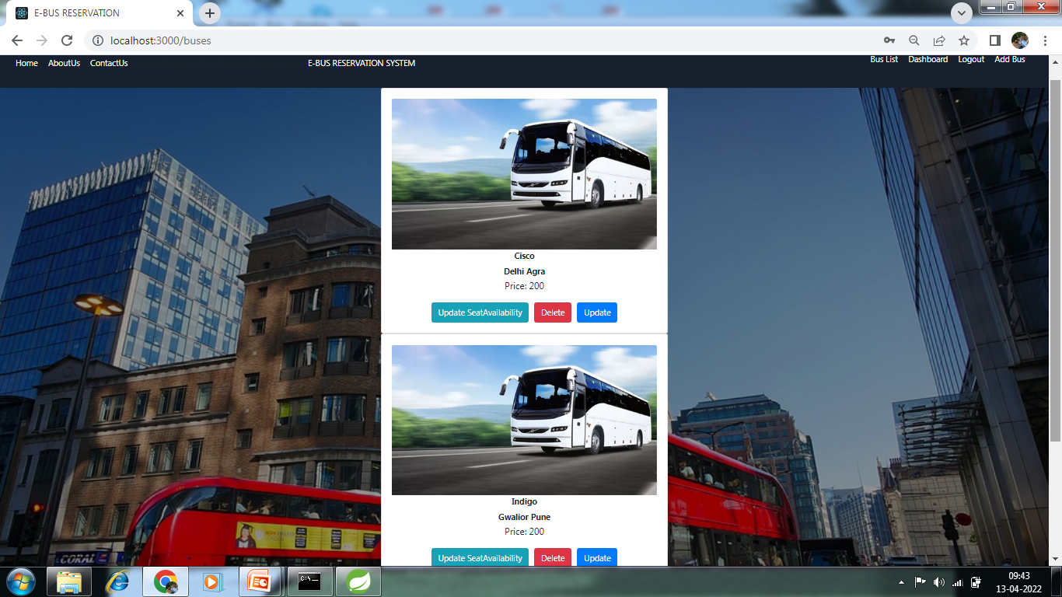
Bus List:

Slide 31
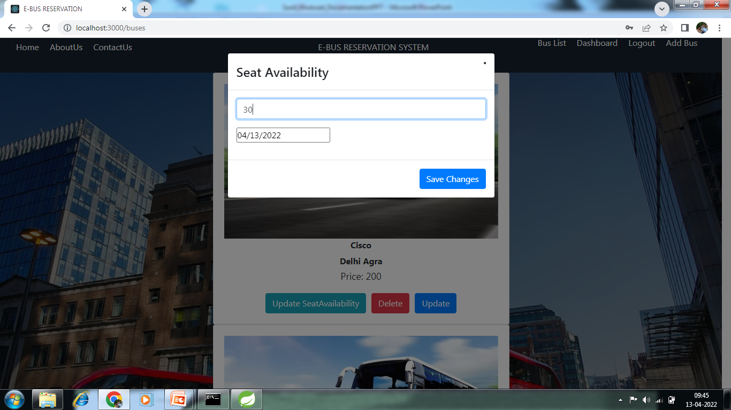
Seat Availability:

Slide 32
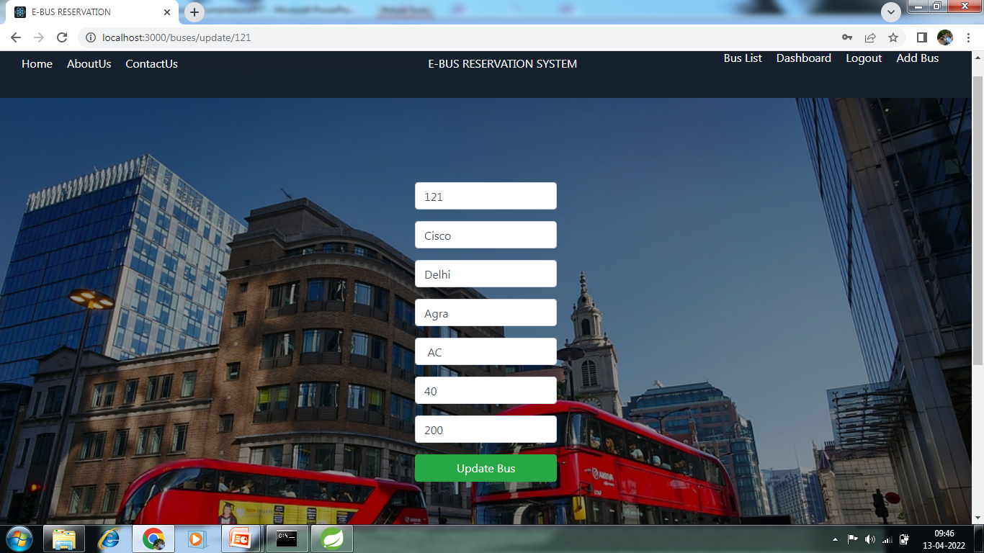
Update Bus:

Slide 33
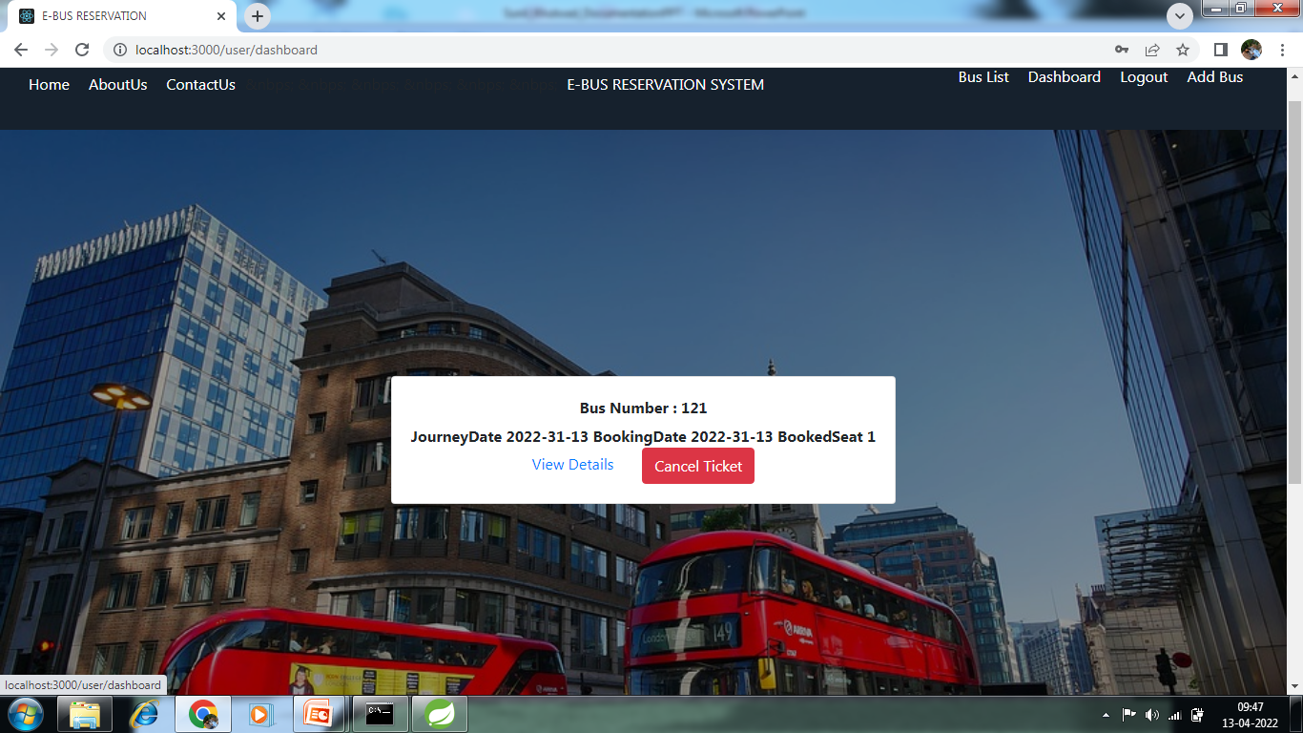
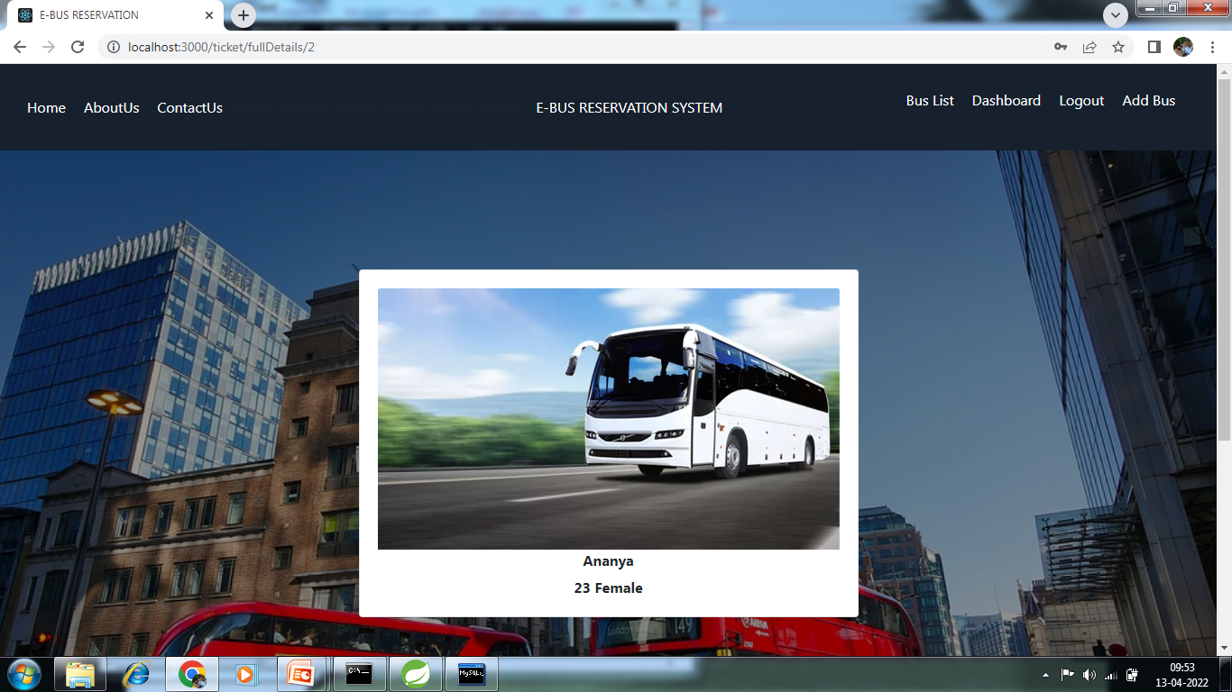
DashBoard:
Ticket Details

Slide 34
User Login Page

Slide 35
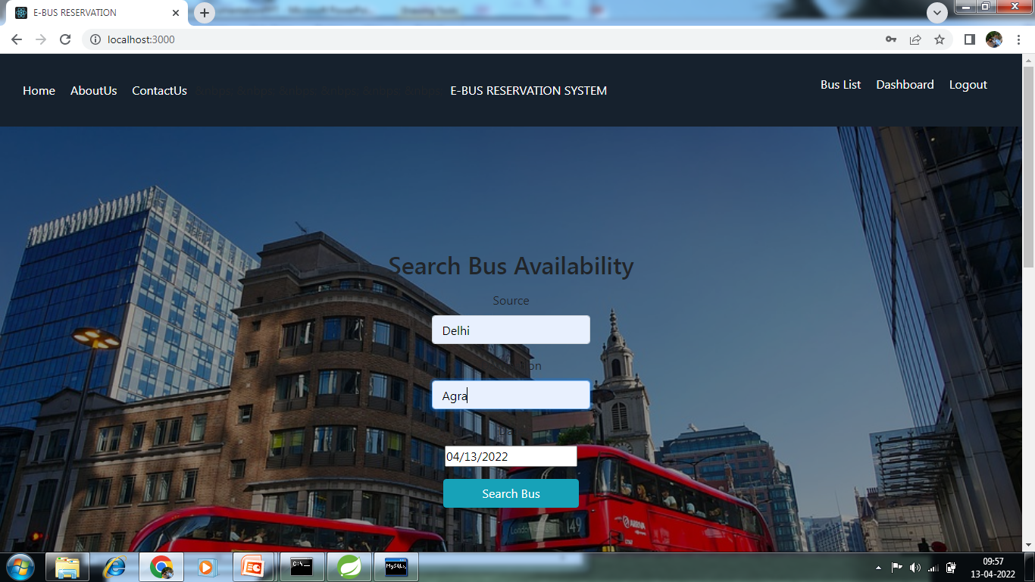
Search bus Availability:

Slide 36
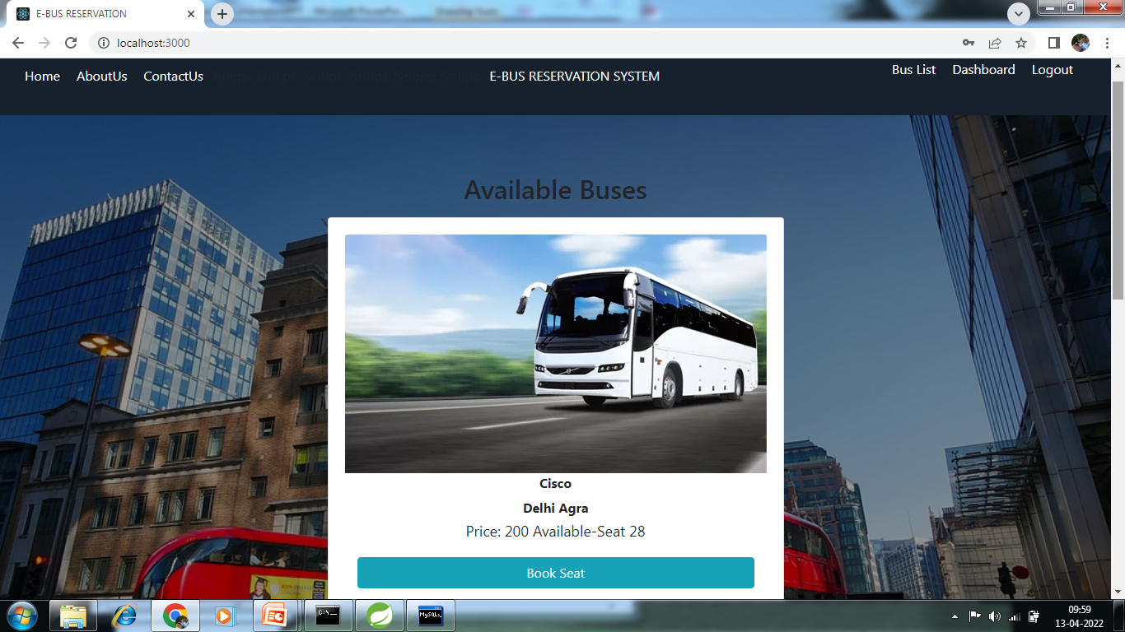
Book Ticket

Slide 37
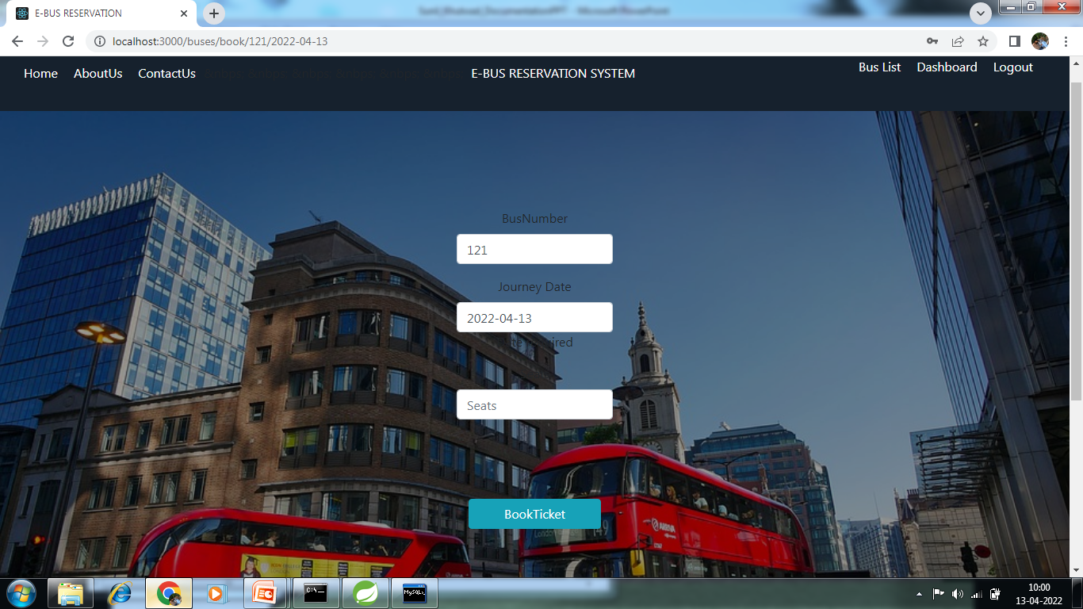
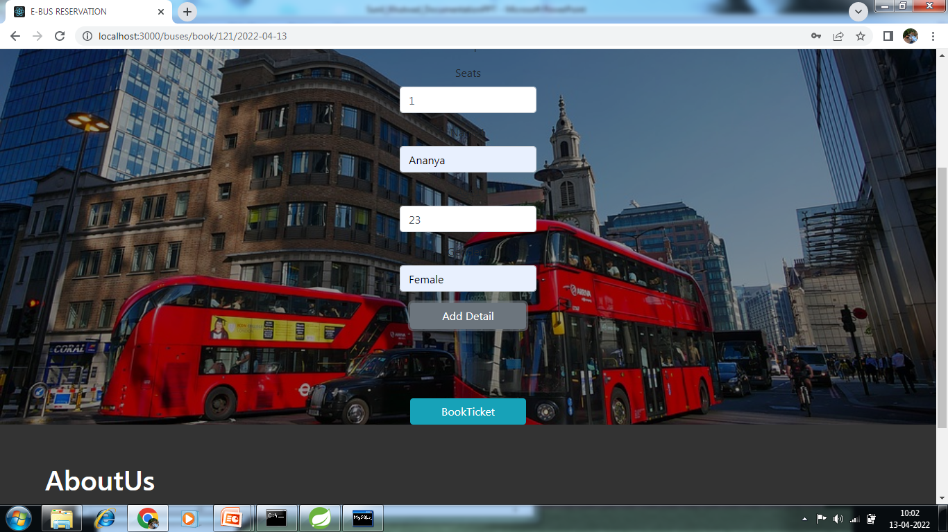
Passenger Details

Slide 38
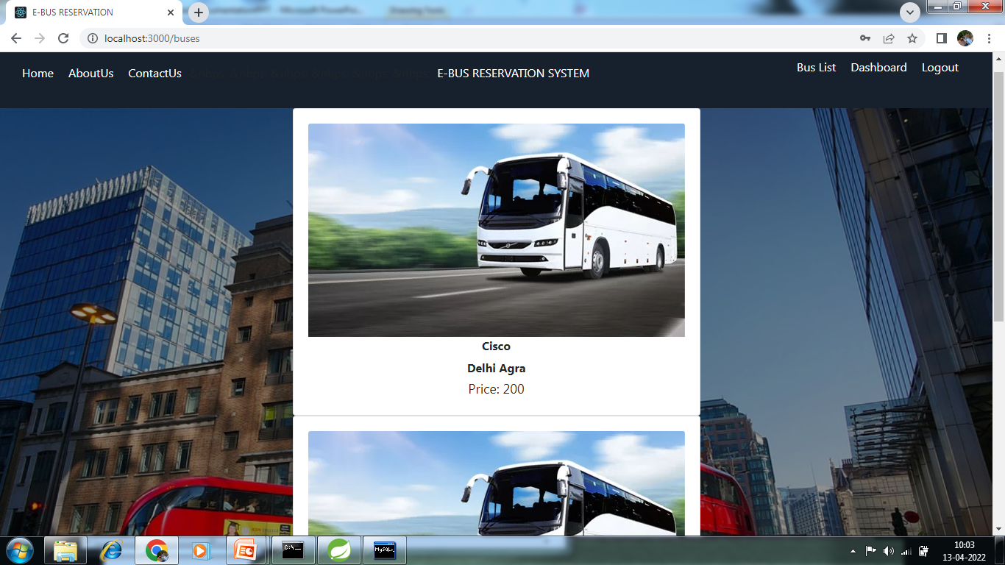
Bus List

Slide 39
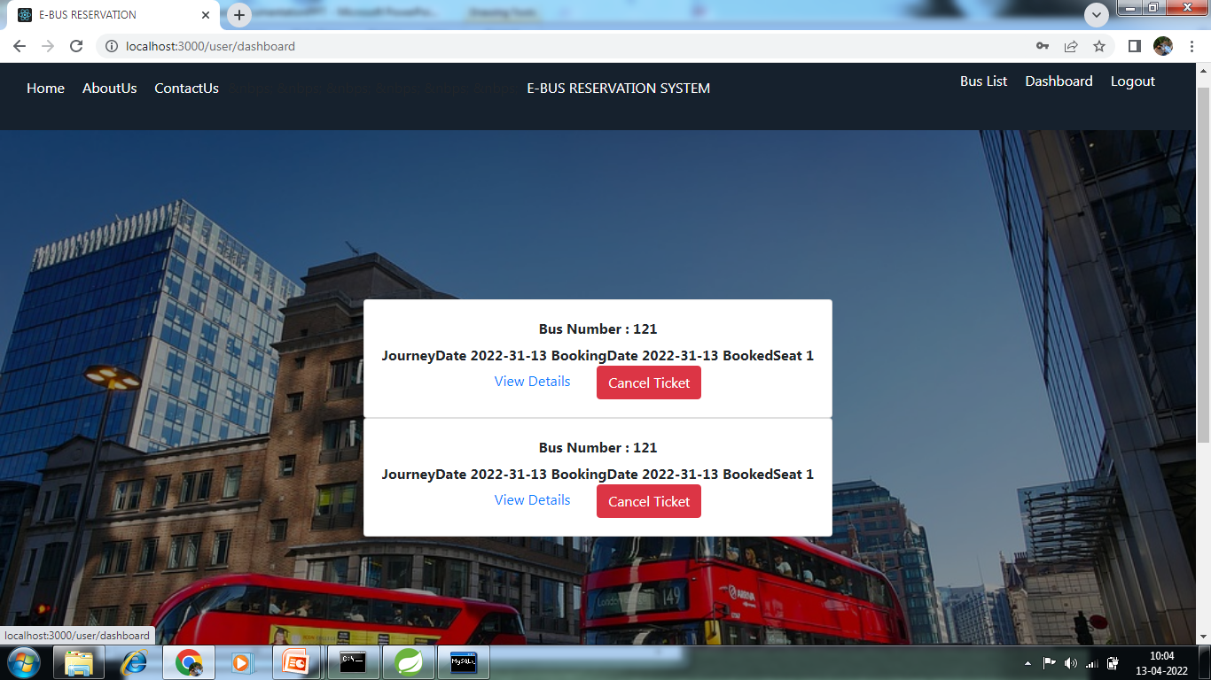
DashBoard

Slide 40
CONCLUSION
E-Bus reservation System which provides online reservation of bus.
This system is user friendly and accurate.
This system is available 24 hours and efficient in reservation.
It has no hidden costs in fares.

Slide 41
References
http://www.google.co.pk/
http://www.javatpoint.com/
http://www.stackoverflow.com/
http://www.w3school.com/

Slide 42
Thank You!!!!

